Slide 1

DATABASES AND APPLICATIONS
SUBJECT CODE : UQ23CA653A
Samyukta D Kumta
Computer Applications

Slide 2
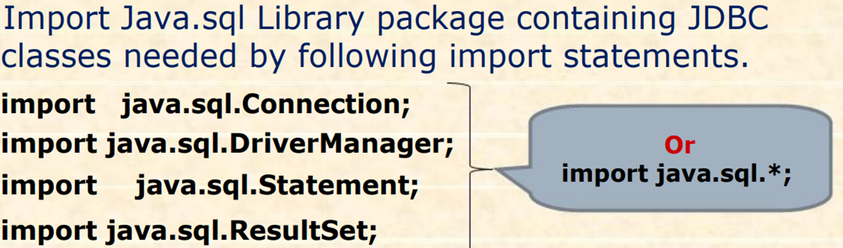
DATABASES AND APPLICATIONS
UNIT-IV- JDBC

Slide 3
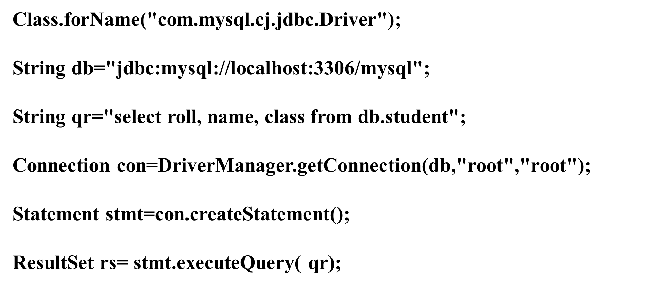
DATABASES AND APPLICATIONS
UNIT-IV- JDBC

Slide 4
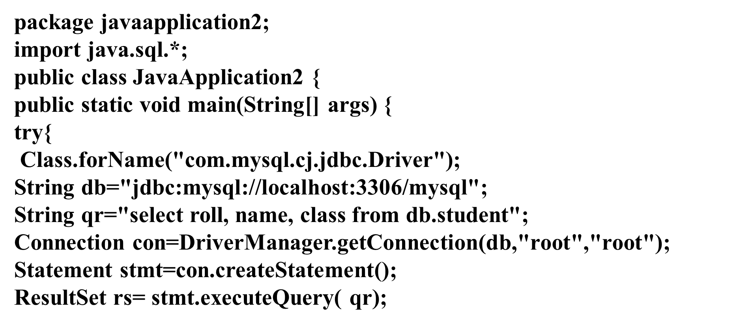
DATABASES AND APPLICATIONS
UNIT-IV- JDBC

Slide 5
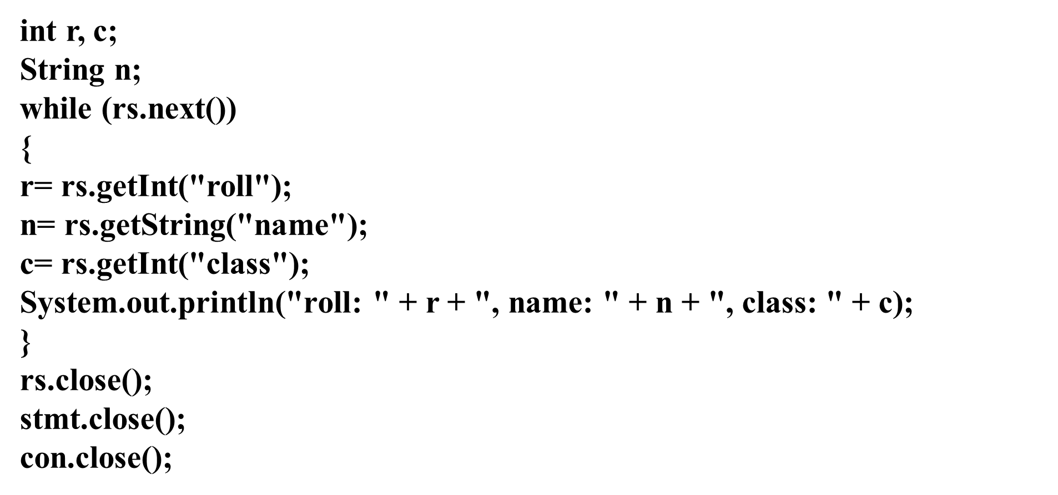
DATABASES AND APPLICATIONS
UNIT-IV- JDBC

Slide 6
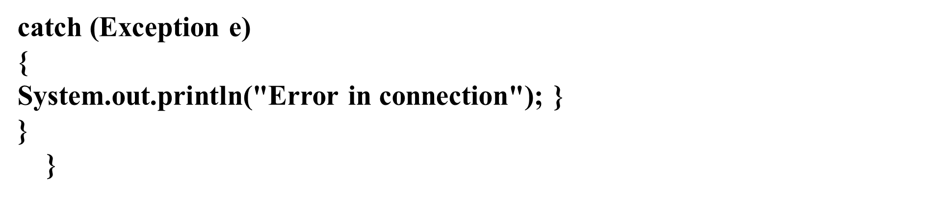
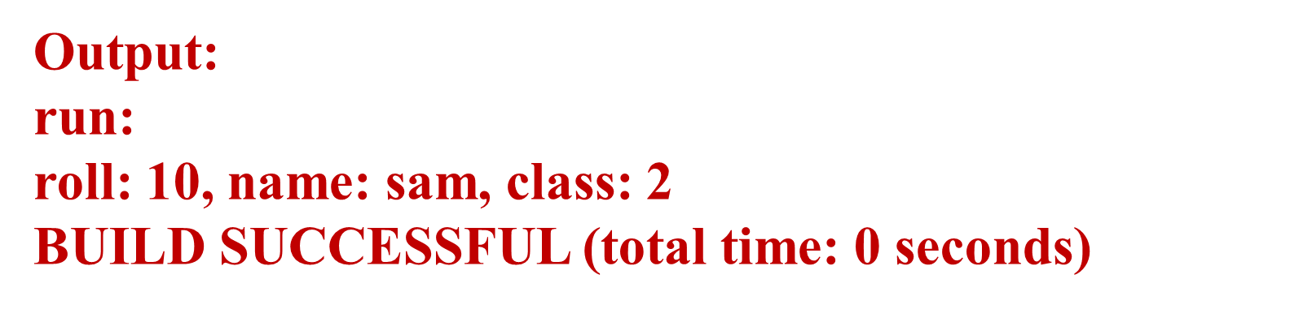
DATABASES AND APPLICATIONS
UNIT-IV- JDBC

Slide 7
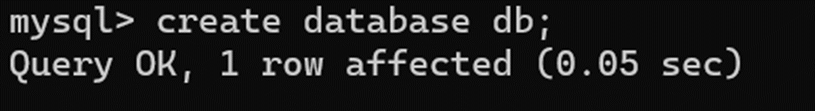
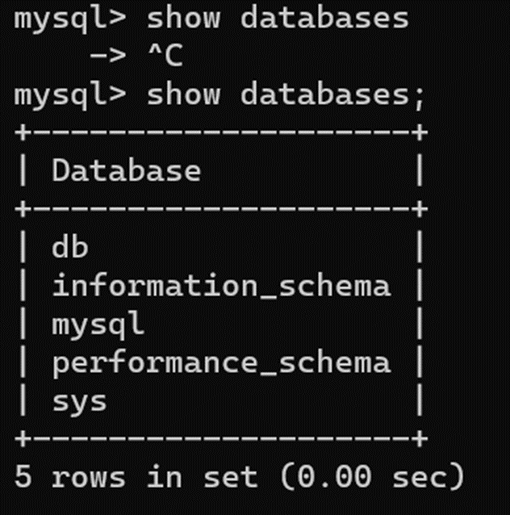
DATABASES AND APPLICATIONS
UNIT-IV- JDBC

Slide 8
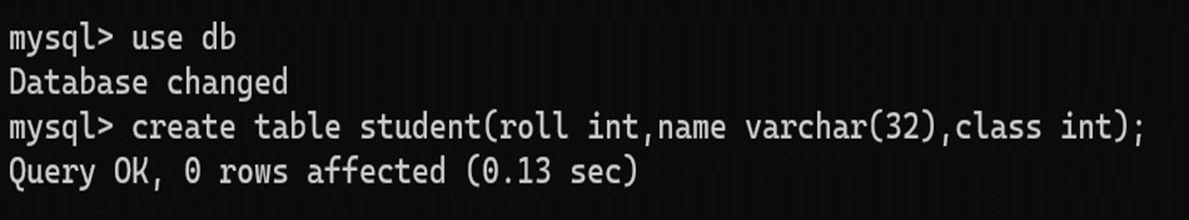
DATABASES AND APPLICATIONS
UNIT-IV- JDBC

Slide 9
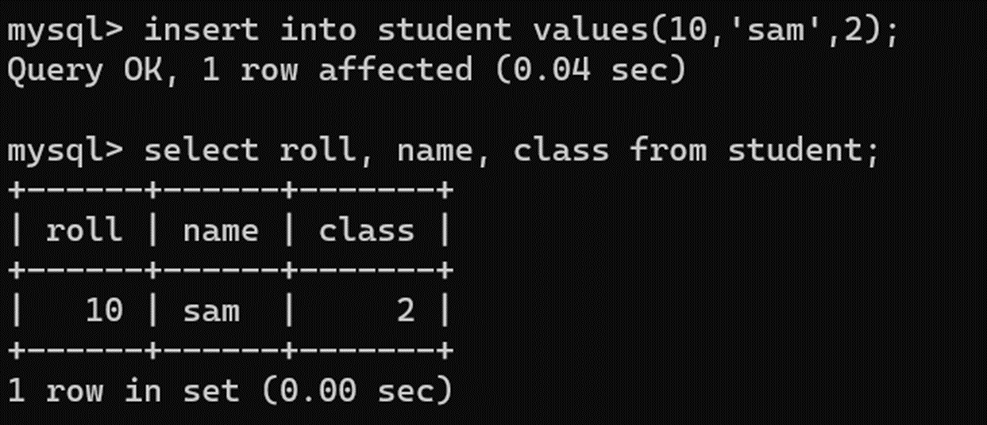
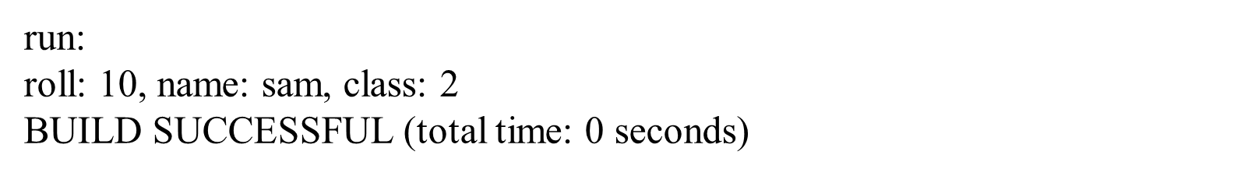
DATABASES AND APPLICATIONS
UNIT-IV- JDBC

Slide 10

THANK YOU
Samyukta D Kumta
Department of Computer Applications
samyuktad@pes.edu

